Slide 1


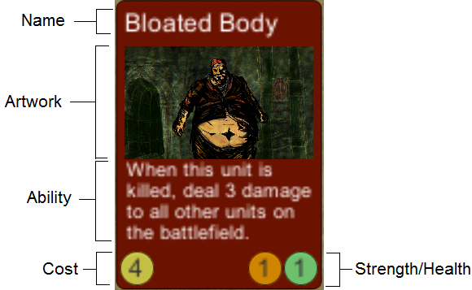
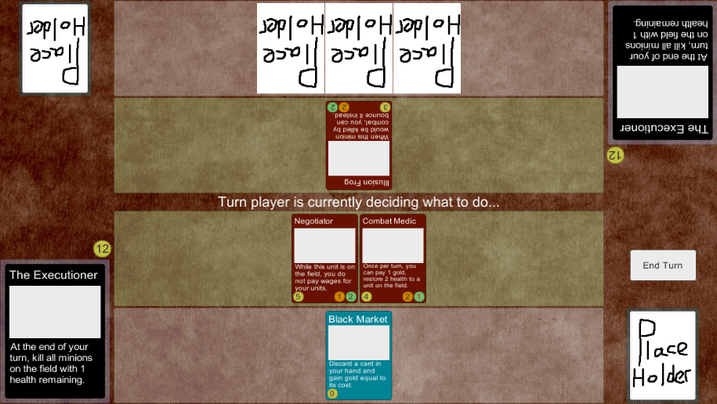

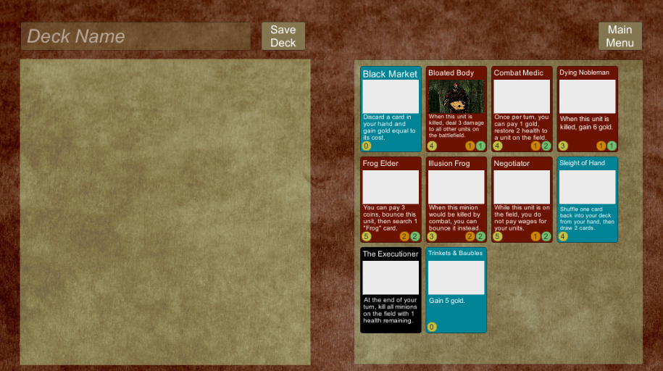

Online Deck-Building Game
Tyler Thorn
Supervisor: Joseph Walton-Rivers

